Slide 1

Internship Project
Drug Persistency
February 2023

Slide 2
Agenda
Executive Summary
Problem Statement
Approach
EDA
EDA Summary
Recommendations

Slide 3
Executive Summary
In the medical field, persistence is defined as continuing a course of therapy prescribed by a medical professional. A pharmaceutical company that can’t keep its customers using its product loses money. It is a well-regarded fact that obtaining new customers is more than double the cost of keeping current ones.
As a society, patients that do not follow long term medical advice drain additional resources from an already overloaded medical system. Low levels of persistency lead to 125,000 deaths per year and cost the U.S. health care system $100 billion annually. (Rubin, 2006).

Slide 4
Approach
Missing Values: There is lots of missing data in the dataset which required a tiered approach:
Dropped rows with NaNs if fields that totaled less than 5% of the overall data.
Dropped fields with missing values that also had high correlation to other features, such as ntm_specialist_flag and ntm_specialist_bucket. Since we already have an ntm_speciality field, we do not need these other aggregated features.
For the missing ntm_speciality features, I imputed data to match the proportion of specialties in the original dataset to avoid over weighting the mode, general practitioner.
Finally, there is roughly a third of the data set that is missing values for the same rows in the following features: change_t_score, risk_segment_during_rx, and tscore_bucket_during_rx. This represents too much of the data set to execute an arbitrary imputation. I conducted a two sample T-test to confirm that NaNs for these fields are not equally distributed in both persistent and not persistent groups.

Slide 5
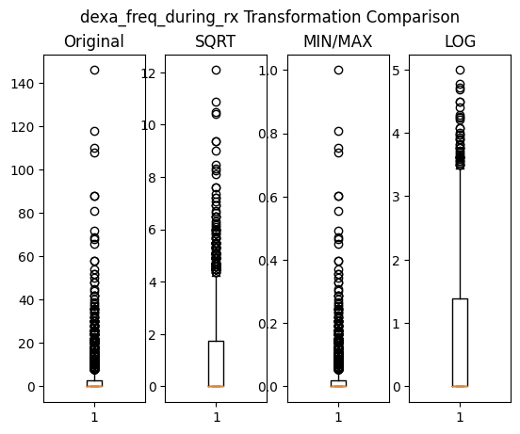
Approach
Multi-collinearity: With nearly 70 features, there are numerous redundant columns in the dataset. Indicators that have both a flag (binary) and measurement field will need to be consolidated to avoid multi-correlation.
Skewness: Although most fields are binary, the several numeric fields both suffer from skewness. Log transformations reduced the effect of outliers. Square root and min-max method did not produce adequate results.

Slide 6
EDA
After EDA and transformation, the dataset now contains 107 features to be used for modeling.

Slide 7
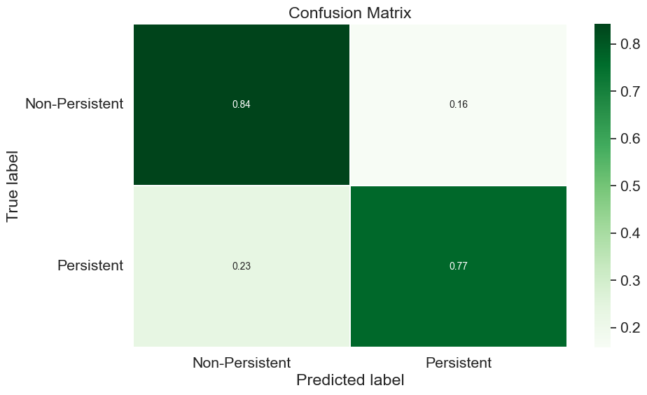
Results
Although the final model predicted patients’ persistency only 77% of the time, it accurately predicts patients who will not persist with treatment 84% of time.
It should be noted, however, this analysis has not developed any causal relationship between the provided dataset features and patient’s persistency tendencies.
I can only correlate a patient’s persistency likelihood with the amount of concomitant medical treatments, primarily Dexa treatment.

Slide 8
Thank You

